Slide 1
Management 515
Human Resource Management
© 2014, 2016 David E. Frick.
All rights reserved.

Slide 2
Definitions
Human Resource Management (HRM). Activities that managers engage in to attract and retain employees and to ensure that they perform at a high level and contribute to the accomplishment of organizational goals.
Recruitment and selection
Training and development
Performance appraisal and feedback
Pay and benefits
Labor relations
Strategic Human Resource Management (SHRM). The process by which managers design the components of a HRM system to be consistent with each other, with other elements of organizational architecture, and with the firm’s strategy and goals. The objective of SHRM is the development of an HRM system that enhances the firm’s efficiency, quality, innovation, and responsiveness to customers

Slide 3
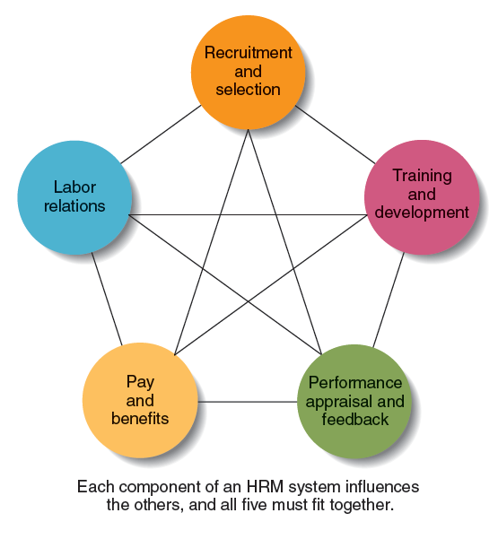
HRM System
Adapted from Contemporary Management, 8th. Jones and Garth
Notes:
Recruitment and Selection. Used to attract and hire new employees who have the knowledge, abilities, skills, and experiences that will help an organization achieve its goals.
Training and Development. Ensures that organizational members develop the skills and abilities that will enable them to perform their jobs effectively in the present and the future. Changes in technology and the environment require that organizational members learn new techniques and ways of working. Generally, firms hire people with the skills they need and only pay train them in special circumstances. However, sometimes, it is cheaper to teach a current employee new skills instead of paying the market rate for the skill with a new employee.
Performance Appraisal and Feedback. Provides managers with the information they need to make good human resources decisions about how to train, motivate, and reward organizational members. I side with Drucker and Deming and believe that formal performance systems have negative effects on firms. Nonetheless, if a firm insists on have a performance system, it must be equitable, unbiased, and designed to reward the behaviors the firm values.
Pay and Benefits. Rewarding high performing members with raises, bonuses and recognition. Some believe that increased pay encourages better performance. I disagree, but we will address that in the lecture on motivation. Benefits are a way to sweeten the pot. Some benefits, such as health insurance under the Affordable Care Act, are now mandatory. The total cost to the employer (pay and benefits) must be considered in making hiring decisions.
Labor relations. Steps that managers take to develop and maintain good working relationships with the labor unions that may represent their employees’ interests. Labor unions are becoming less and less relevant; however, firms must ensure that human resource departments meet the needs of the firm and properly address all matter of employer-employee relations.

Slide 4
Contemporary Challenges
Eliminating exposure to sexual harassment or hostile work environment litigation
Accommodating employees with disabilities under the Americans with Disabilities Act of 1990
Dealing with employees who have substance abuse problems
Managing the effects of HIV-positive employees and employees with AIDs, Ebola, the flu, etc.
Notes:
Claims of sexual harassment can be expensive for firms to defend in court. To protect the firm, management must ensure that:
Policies prohibiting sexual harassment and hostile work environments exists.
Employees are aware of the policies.
Policies are enforced.
No allegation is ignored. The decision might be to do nothing, but the investigation of the accusation must be performed.
The Americans with Disabilities Act (ADA) requires employers with 15 or more employees to provide qualified individuals with disabilities an equal opportunity to benefit from the full range of employment-related opportunities available to others. For example, it prohibits discrimination in recruitment, hiring, promotions, training, pay, social activities, and other privileges of employment. It restricts questions that can be asked about an applicant's disability before a job offer is made, and it requires that employers make reasonable accommodation to the known physical or mental limitations of otherwise qualified individuals with disabilities, unless it results in undue hardship. What is reasonable and what is undue is a question still being addressed in the courts.
Sometimes, if might be cost effective to treat employees with substance abuse issues, however, a firm should always have a policy to establish expectations.
Dealing with employees with communicable diseases is a very complex issue. Read the document Moodle, “Infectious Disease in the Workplace.”

Slide 5
Legal Environment
Equal Employment Opportunity (EEO). The right of all citizens to the opportunity to obtain employment regardless of their sex, age, race, country of origin, religion, or disabilities
Equal Employment Opportunity Commission (EEOC) enforces employment laws
Americans with Disabilities Act of 1990. Prohibits discrimination based on disability. Requires reasonable accommodation for firm’s with more than 50 employees
Notes:
In the United States, laws protecting employment exist. The Equal Employment Opportunity Commission (EEOC) is the federal agency that administers and enforces these laws. The EEOC investigates discrimination complaints of race, color, national origin, religion, sex, age, disability, genetic information, and retaliation for reporting, discriminatory practices. The Commission also mediates and settles discrimination complaints and is empowered to file civil discrimination suits against employers.
The EEOC has been criticized for some of its rulings, such as advice that requiring a high school diploma from job applicants could violate the Americans with Disabilities Act. The advice letter stated that the longtime lowest common denominator of employee screening must be "job-related for the position in question and consistent with business necessity." The EEOC has been criticized for its heavy-handed tactics. Based on a statistical analysis of personnel and promotions, EEOC argued that one firm was systematically excluding women from high-earning positions in commission sales, and was paying female management lower wages than male management. The firm counter-argued that the company had in fact encouraged female applicants for sales and management, but that women preferred lower-paying positions with more stable daytime working hours, as compared to commission sales which demanded evening and weekend shifts and featured drastically varying pay. The courts ruled in favor of the firm, noting that the EEOC had not produced a single witness who alleged discrimination, nor had the EEOC identified any Sears policy that discriminated against women.
The EEOC was a long-standing approach to arguing discrimination: post hoc, ergo propter hoc. The EEOC assumes that if the demographics of your workforce are not identical to the demographics of the local community, then discriminatory practices exist and you must prove they do not—in essence, guilty until proven innocent.

Slide 6
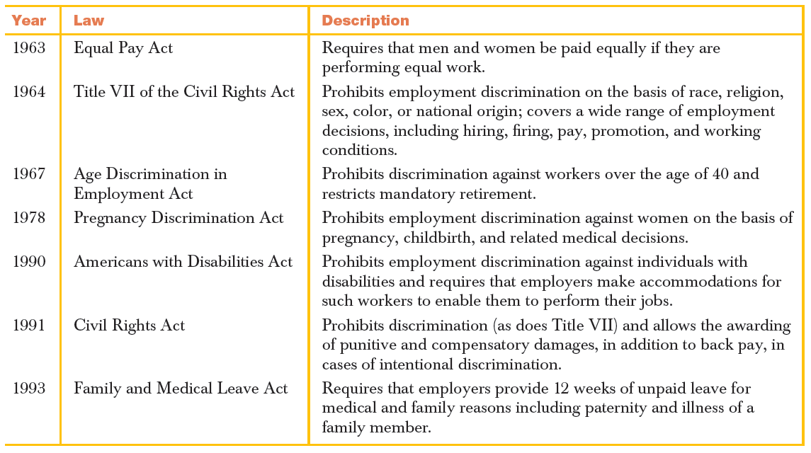
Legal Environment
Notes:
Here are the major laws passed in the last 50 years that address employer obligations in the hiring process.

Slide 7
Definitions
Recruitment. Activities that managers engage in to develop a pool of candidates for open positions
Selection. The process that managers use to determine the relative qualifications of job applicants and their potential for performing well in a particular job
Outsourcing
Using outside suppliers and manufacturers to produce goods and services
Using contract workers rather than hiring them

Slide 8
Human Resource Planning (HRP)
Activities that managers engage in to forecast their current and future needs for human resources
Demand forecasts. Estimates the qualifications and numbers of employees the firm will need given its goals strategies
Supply forecasts. Estimates the availability and qualifications of current employees now and in the future, as well as the supply of qualified workers in the external labor market
Gap analysis. The analysis of knowledge, skills, and abilities (KSAs) of the current workforce and those KSAs that are or will be needed
Notes:
The planning processes of firms should not only define what will be accomplished within a given time, but also the skills that will be needed to achieve the defined business goals (e.g., knowledge, skills, abilities, and training of employees and number of employees).
Firms should evaluate the skill mix of the workforce on a regular basis to ensure that the workforce is moving the firm in the desired direction. The overall objective of human resource planning is to ensure the best fit between employees and jobs, while avoiding workforce shortages or excesses. The three key elements of the HR planning process are forecasting labor demand, analyzing present labor supply, and then taking action to balance projected labor demand and supply.

Slide 9
Job Roles
Job Analysis. Identifying the tasks, duties and responsibilities that make up a job and the knowledge, skills, and abilities needed to perform the job
Job analysis methods
Observing what current workers do
Having workers and manages fill out questionnaires
Job compensation should be proportional to complexity
Notes:
Job analysis is a process of collecting information about a job. The process results in two sets of data: job description and job specification.
Job Description provides both organizational information (e.g., location in hierarchy and authority) and functional information (what the work is). This information gives the worker, analyst, and supervisor a clear idea of what the employee must do to meet the demand of the job. The job description must:
--indicate the scope and nature of the work including all-important relationships.
--be clear regarding the work of the position, duties etc.
--be specific about the kind of work, complexity of the work, the degree of skill required, the extent to which problems are addressed, and the extent of employee’s responsibility for each phase of the work
Job Specification is the information about:
--Physical specifications: include the physical qualifications or physical capacities that vary from job to job to include physical features like height, weight, size, vision, hearing, ability to lift weight, ability to carry weight, health, age, capacity to use or operate machines, tools, equipment etc.
--Mental specifications: include ability to perform arithmetic calculations, to interpret data, to read, to plan, judgment, ability to concentrate, ability to handle variable factors, general intelligence, memory, etc.
--Emotional and social specifications: emotional stability, flexibility, social adaptability in human relationships, personal appearance including dress, posture, etc.
--Behavioral Specifications: include judgments, research, creativity, teaching ability, maturity, self-reliance, dominance, etc.

Slide 10
External Recruiting
Looking outside the organization for people who have not worked at the firm previously.
Access to a potentially large applicant pool
Ability to attract people who have the skills, knowledge, and abilities an organization needs
Brings in newcomers who may have a fresh approach to problems and current with the latest technology
Targeted recruiting includes advertising needs in newspapers and at open houses, career fairs at colleges, and recruiting meetings with groups in the community

Slide 11
Internal Recruiting
Managers turn to existing employees to fill open positions
Internal applicants are already familiar with the organization
Managers already know candidates (better the devil you know than the devil you don’t know)
Can help boost employee morale
An internal recruiting only policy can limit innovation in a firm
Notes:
Whether a firm looks to the outside or the inside to fill positions is a function of judgment. Both approaches have their advantages.
Hiring from within means you hire someone who as familiar with the firm and the form’s culture, has a proven track record, and has a proven record as a fit for the firm.
Hiring from without is the opportunity to bring in new skills and new ideas.

Slide 12
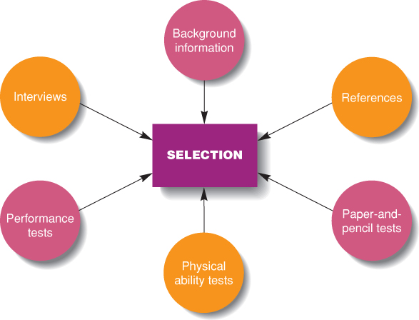
How to Differentiate Candidates?
Adapted from Contemporary Management, 8th. Jones and Garth
Notes:
Testing of all kinds is acceptable as long as it meets a legitimate business need.
Laws vary from state to state about what you can do to evaluate a candidate. For example, in some states you cannot ask a candidate whether the candidate has been convicted of a felony. The belief is that even felons need a fair chance to find a job. Others, disagree.
However, if you can show a legitimate business need, the courts tend to side with the employer.
Here are two examples. At one time, the airline industry required flight attendants (who were called stewardesses back then) to be females under 103 pounds. The argument was that smaller women were a business necessity to save fuel. Smaller people caused the air craft to burn less fuel. The fact that they were all attractive was only a coincidence. The courts did not buy the argument since the airlines did not apply the same standard to pilots or passengers.
On the other hand, the restaurant Hooters only hires women of a specific body type. Hooters argues that the restaurant has an image to uphold. In this case, the court has sided with the restaurant.

Slide 13
Training and Development
Training. Teaching organizational members how to perform current jobs and helping them to acquire the knowledge and skills they need to be effective performers.
Development. Building the knowledge and skills of organizational members to enable them to take on new responsibilities and challenges.
Needs Assessment. An assessment of which employees need training or development and what type of skills or knowledge they need to acquire
Notes:
How much a firm spends to train and develop its workforce is a matter of judgment. In general, firms hire the skills it needs and does not pay for additional training.
However, it is sometimes better for the firm to pay for the training for a specific skill. For example, if a firm is unable to find a qualified candidate with a specific skill, it might train an existing employee in that specific skill.
Some firms encourage formal education. For example, Northrup Grumman will pay the full cost of higher education. If you already had a PhD, Northrup will pay for a second one. The company believes that this reflects well on its reputation and is worth the cost.
Firms must constantly make the cost-benefit analyses for its training and development policies.

Slide 14
Performance Appraisals
The evaluation of employees’ job performance and contributions to the firm’s performance
Evaluates traits, behaviors, results
Traits. Loyalty, dedication, dependability, dedication
Behaviors. Timeliness, friendliness, attitude, communication skills
Results. Outcomes (or outputs) vs. goals
Usually on some Likert-like scale
Notes:
A performance appraisal is a systematic and periodic process that assesses an individual employee’s job performance in achieving organizational goals. Other aspects of individual employees can be considered as well, such behavior, potential for future improvement, strengths and weaknesses, etc. Historically, appraisals have been conducted annually; however, many companies are moving towards shorter cycles, even weekly. Appraisals can be used to provide feedback, counseling, and developing employees, and as a way to justify compensation, job status, or disciplinary actions.
A central argument for the use of appraisals is performance improvement, establishing as a basis for employment decisions (e.g. promotions, terminations, transfers), to aid with communication (e.g., letting employees know how they are meeting organizational expectations), to establish personal objectives for training, and as a means to document actions in in wage and salary administration.
Appraisals can aid in the formulation of job criteria and selection of individuals who are best suited to perform specific jobs, as a guide for employee career development, and an aid to work motivation.
At this point, I must voice my opposition to performance appraisals. Both Peter Drucker and W. Edwards Deming argue that appraisals have a net negative effect on firms. I concur. The biases that we all hold make the creation of a totally objective performance evaluation system (and its implementation) a near impossibility. No matter how fair you think you are, someone, somewhere will disagree with you. These perceptions of unfairness (remember Equity Theory and Expectancy Theory) have negative outcomes that overshadow the potential positive aspects of a performance system. I admit this puts firms is a tough position. Without the documentation of performance appraisals, how do you justify management decisions such as promotions, raises, and punishments?

Slide 15
Sources of Evaluation Information
360
Self
Supervisors
Peers
Subordinates
Customers
Reports
Notes:
Many types of appraisals exist.
Self--Self appraisals can supplement manager view.
Peer appraisal--Coworkers provide appraisal; common in team settings.
360 Degree--performance appraisal by peers, subordinates, superiors, and clients who are in a position to evaluate a manager’s performance. 360 evaluations are argued as the most objective (fairest) of any system. However, the cost of these evaluations have been empirically shown to exceed the benefit.
The most meaningful appraisals can be those rendered by outside parties, e.g., customers, who are not as affected by biases. Automated reports, e.g., sales reports, are the most objective, but forms must ensure they are evaluating the right thing—are the firm’s goals sales or profits?

Slide 16
Types of Appraisals
Formal appraisals. An appraisal conducted at a set time during the year and based on performance dimensions that were specified in advance
Informal appraisals. An unscheduled appraisal of ongoing progress and areas for improvement
Notes:
We have discussed formal appraisals.
I consider informal appraisals, where a supervisor sits down with the employees and chats about performance, to be the most useful. These sessions should be frequent—not so often as to interrupt the work, but often enough to ensure the employee gets feedback in a timely manner.

Slide 17
Pay and Benefits
Pay
Includes employees’ base salaries, pay raises, and bonuses
Determined by characteristics of the organization, the labor market, the job complexity, and levels of performance
Benefits
Required. Social security, workers’ compensation, unemployment insurance
Optional. Health insurance, retirement, paid leave, day care, flex-time, telework
Cafeteria-style benefits plans allow employees to choose the best mix of benefits for them, but can be hard to manage
Notes:
The take away from this slide is, firms must always consider the total cost of compensation—pay and benefits—when making hiring decisions.

Slide 18
Policies
Pay policy
Leading. Firm pays workers more than prevailing rate
Matching. Firm matches prevailing rate
Lagging. Firm pays less that prevailing rate
Hiring
Preference to internal hiring
Preference to external hiring
Personnel
Dress
Relationships
Notes:
A firm’s pay policy can have far-reaching affects on the firm’s performance.
To attract the best and brightest candidates, firms will often pay more than the market rate for a skill.
At times, a firm might want to pay below the market rate, e.g., when cash is tight and the labor market is soft.
In the long run, firm’s tend to regress to the market average.
Please read the article in Moodle on pay policy.

Slide 19
Workforce Relations
Labor Relations. The activities managers engage in to ensure they have effective working relationships with the labor unions that represent their employees interests
Unions. Supposedly represent worker’s interests to management in organizations
Collective bargaining. Negotiation between labor and management to resolve conflicts and disputes about issues such as working hours, wages, benefits, working conditions, and job security

Slide 20
Consider This
Both Drucker and Deming argue the performance evaluation systems have a negative effect on business
Complexity drives compensation, not amount of work. If you are doing the work of two people, hire another person
Labor union participation is at lowest level since 1950s
Policies must be codified
To ensure employees understand them
To overcome the presumption of responsibility
To protect the firm from litigation

